Slide 1



WELCOME…..!
1
Sanjivani College of Engineering, Kopargaon.

Slide 2
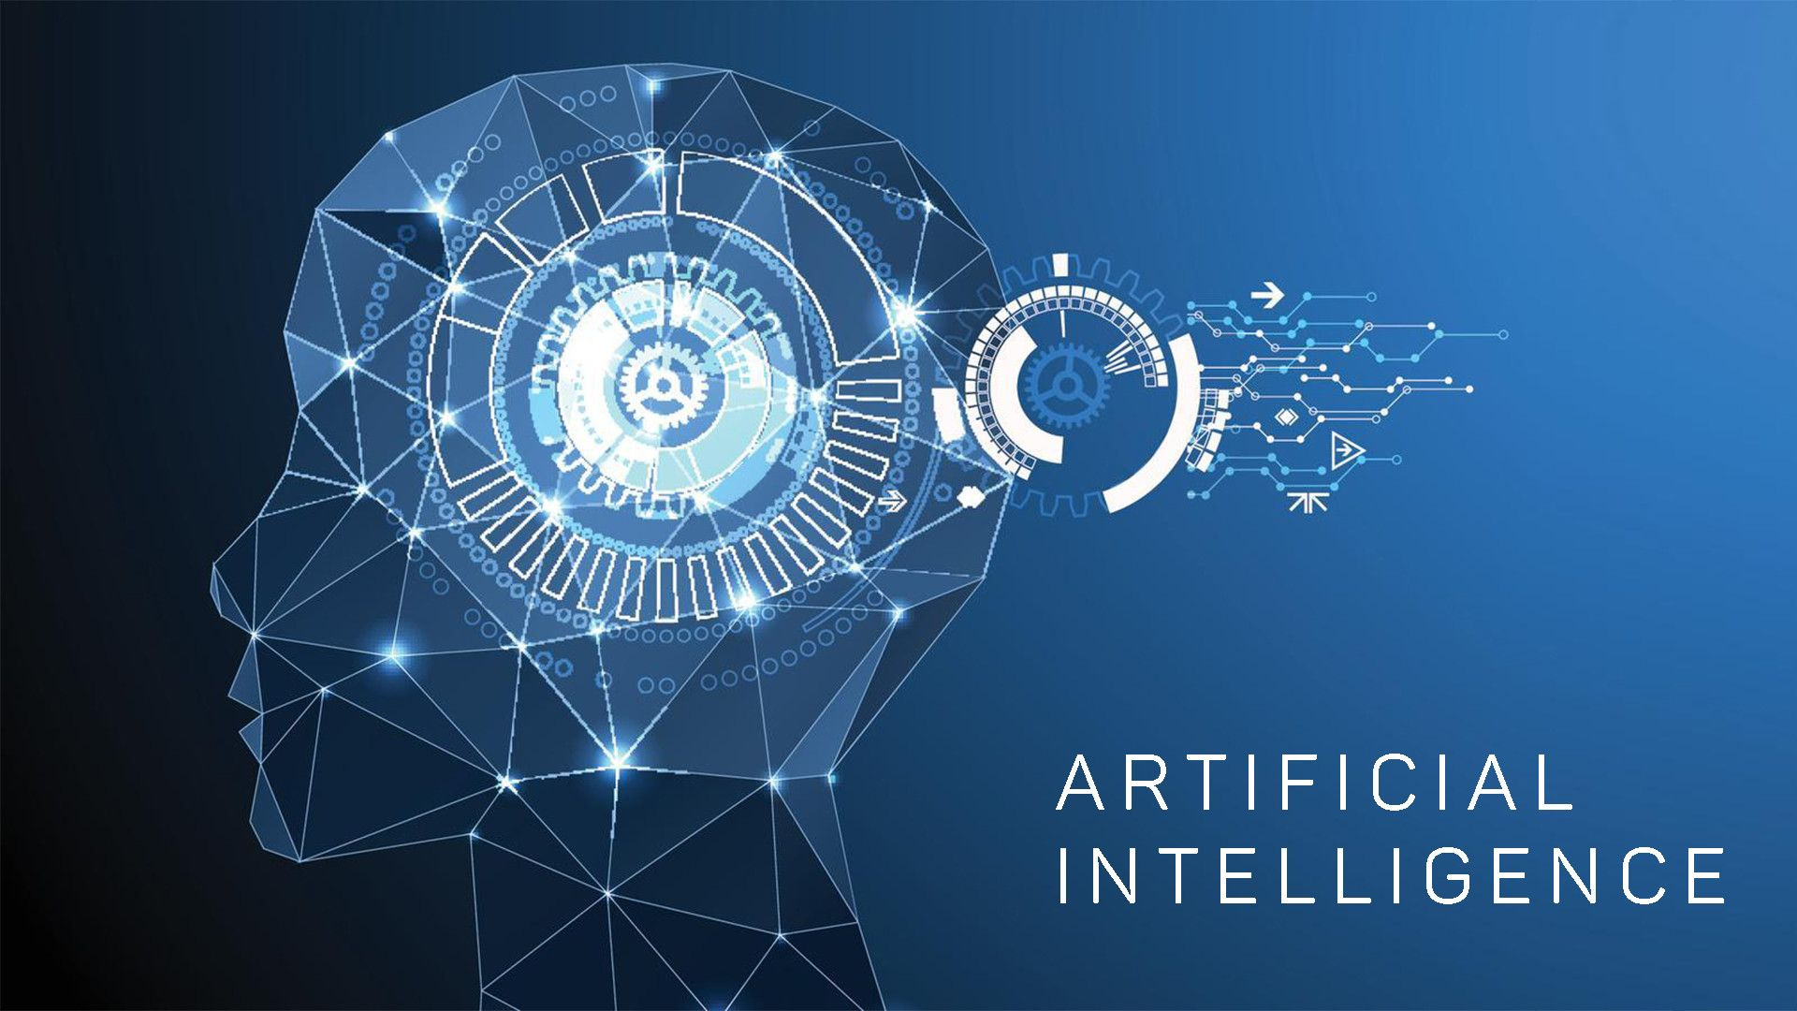
Mechanical Engineering
B – Division
Group -4
Under The Guidance of
Prof. Y. A. Bhavasar
PRESENTED BY
KESHAV R. MORE
VIVEK A. MULE
PRANAV S. NAGARE
TEJAS B. NALKAR
PRANAV V. NILE
1
Sanjivani College of Engineering, Kopargaon.

Slide 3
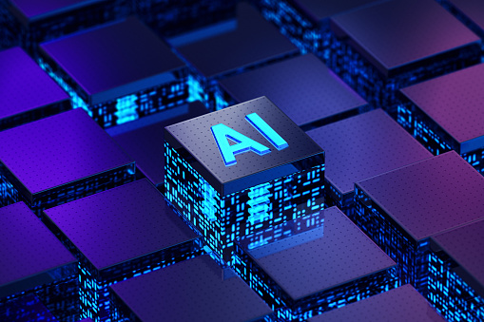
ARTIFICIAL INTELLIGENCE
Artificial intelligence (AI) is the ability of a computer or a robot controlled by a computer to do tasks that are usually done by humans because they require human intelligence and discernment.
AI was a term first coined at Dartmouth College in 1956.
The first work which is now recognized as AI was done by Warren McCulloch and Walter pits in 1943. They proposed a model of artificial neurons.
Donald Hebb demonstrated an updating rule for modifying the connection strength between neurons. His rule is now called Habana learning.
1
Sanjivani College of Engineering, Kopargaon.

Slide 4
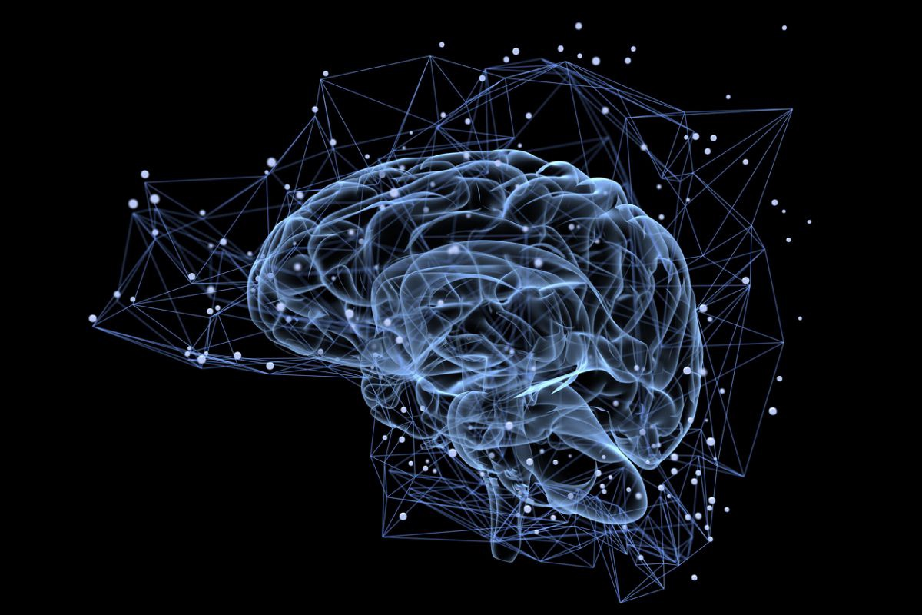
The birth of Artificial Intelligence (1952-1956)
Year 1955: An Allen Newell and Herbert A. Simon created the "first artificial intelligence program "Which was named as "Logic Theorist".
This program had proved 38 of 52 Mathematics theorems, and find new and more elegant proofs for some theorems.
Year 1956: The word "Artificial Intelligence" first adopted by American Computer scientist John McCarthy at the Dartmouth Conference. For the first time, AI coined as an academic field.
1
Sanjivani College of Engineering, Kopargaon.

Slide 5
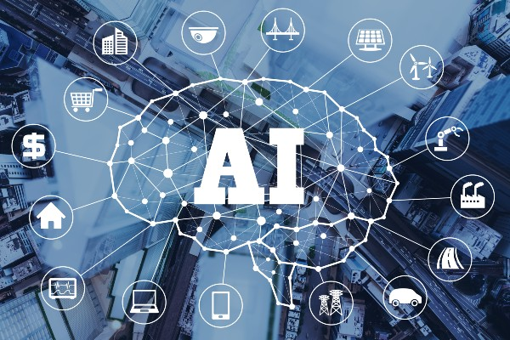
APPLICATION OF ARTIFICIAL INTELLIGIENCE
MACHINE LEARNING
ROBOTICS
IOT
DEEP LEARNING
1
Sanjivani College of Engineering, Kopargaon.

Slide 6
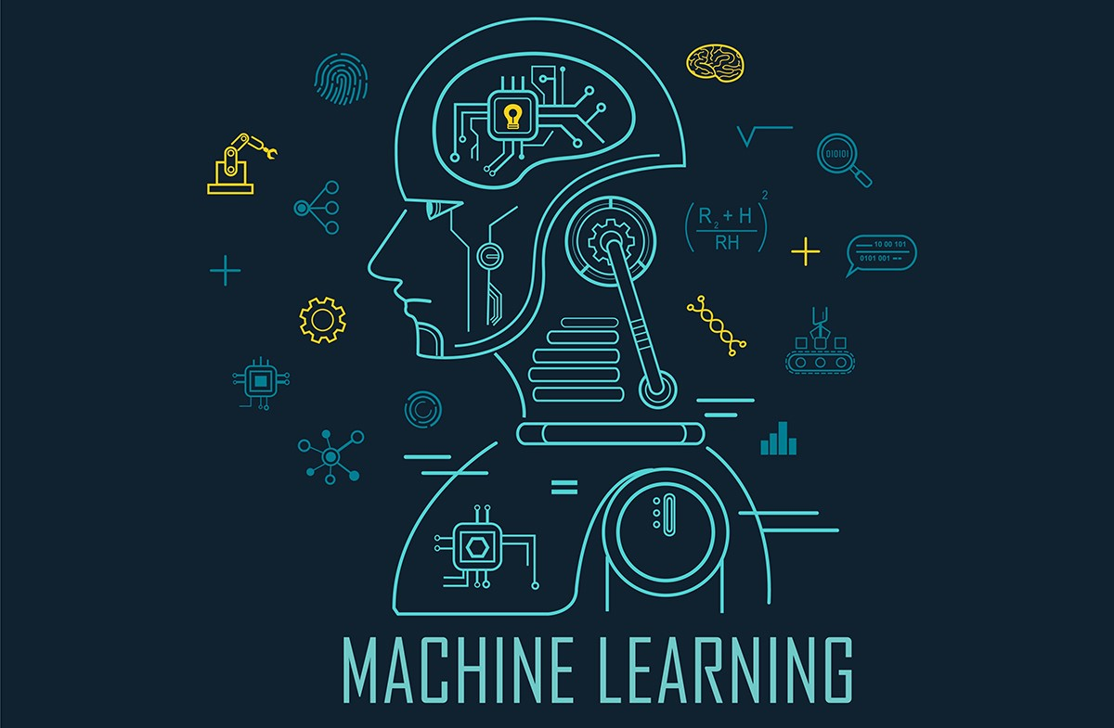
MACHINE LEARNING
The term machine learning was coined in 1959 by Arthur Samuel, an IBM employee and pioneer in the field of computer gaming and artificial intelligence.
Machine learning (ML) is a field of inquiry devoted to understanding and building methods that 'learn', that is, methods that leverage data to improve performance on some set of tasks.[It is seen as a part of artificial intelligence.
Machine learning was first conceived from the mathematical modeling of neural networks.
1
Sanjivani College of Engineering, Kopargaon.

Slide 7
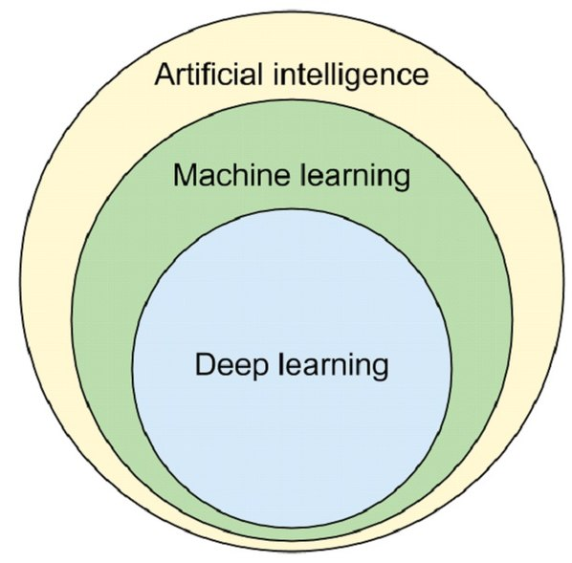
A paper by logician Walter Pitts and neuroscientist Warren McCulloch, published in 1943, attempted to mathematically map out thought processes and decision making in human cognition
Machine learning has become a very important response tool for cloud computing and ecommerce, and is being used in variety of cutting edge technologies.
After AI(Artificial intelligence) Machine learning having importance
1
Sanjivani College of Engineering, Kopargaon.

Slide 8
Application Of Machine Learning
Agriculture
Anatomy
Banking
Bioinformatics
Computer Networks
6. Computer Vision
1
Sanjivani College of Engineering, Kopargaon.

Slide 9
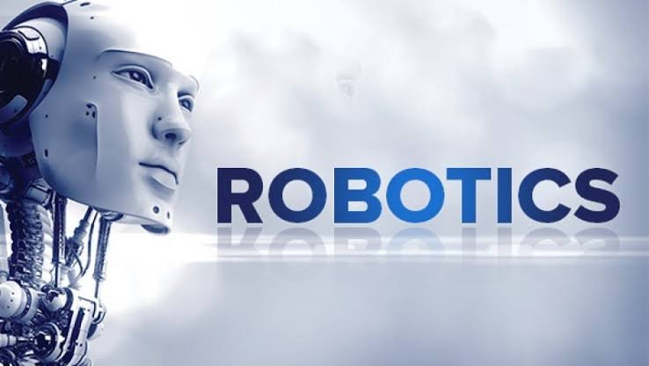
ROBOTICS
A ROBOT is a mechanical or virtual artificial agent, usually an electro-mechanical machine that is guided by a computer program or electronic circuitry. Robots can be autonomous or semi-autonomous. A Robot may convey a sense of intelligence or thought of its own.
Honda's Advanced Step in Innovative Mobility (ASIMO) and TOSY'S TOSY Ping Pong Playing Robot (TOPIO) to Industrial robots, medical operating robots, patent assist robots, dog therapy robots, collectively programmed Swarm robots,
1
Sanjivani College of Engineering, Kopargaon.

Slide 10
Definition of robotics
A robot is a machine that gathers information about its environment (senses) and uses that information (thinks) to follow instructions and to do work (acts).
A robot may act under the direct control of a human, such as the arm on a space shuttle, or under the control of a programmed computer.
1
Sanjivani College of Engineering, Kopargaon.

Slide 11
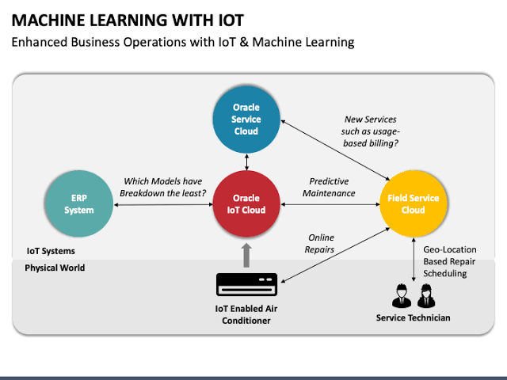
IOT
1
Sanjivani College of Engineering, Kopargaon.

Slide 12
The internet of things is a technology that allows us to add a device to an inert object (for example: vehicles, plant electronic systems, roofs, lighting, etc.) that can measure environmental parameters, generate associated data and transmit them through a communications network.
The internet of things (IoT) is a set of technologies that uses sensors and actuators to inform us about the status of everyday items such as vehicles, tools and even living beings.
1
Sanjivani College of Engineering, Kopargaon.

Slide 13
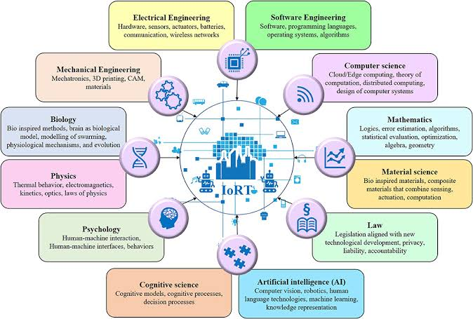
1
Sanjivani College of Engineering, Kopargaon.

Slide 14
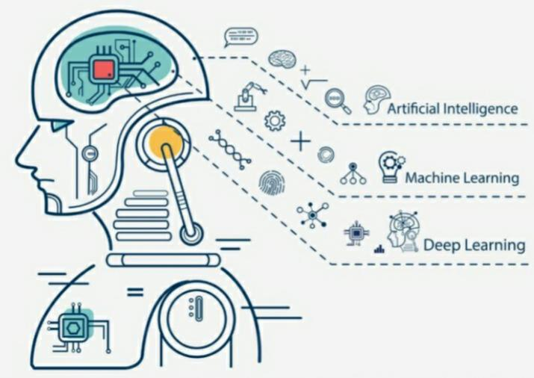
Deep learning
Deep learning is a type of machine learning and artificial intelligence (AI) that imitates the way humans gain certain types of knowledge
Deep learning is an important element of data science, which includes statistics and predictive modeling
It is extremely beneficial to data scientists who are tasked with collecting, analyzing and interpreting large amounts of data; deep learning makes this process faster and easier.
1
Sanjivani College of Engineering, Kopargaon.

Slide 15
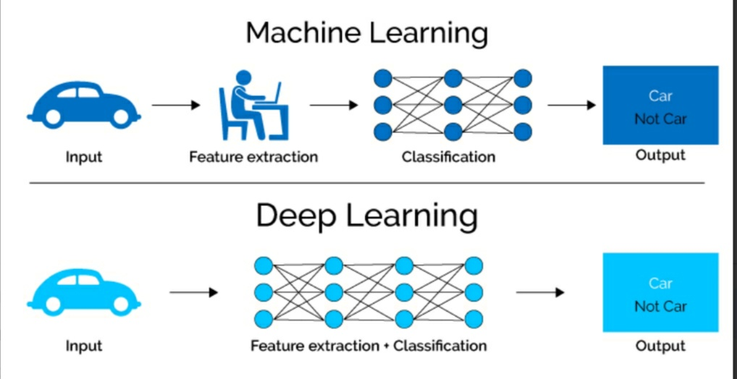
At its simplest, deep learning can be thought of as a way to automate predictive analytics.
While traditional machine learning algorithms are linear, deep learning algorithms are stacked in a hierarchy of increasing complexity and abstraction.
Deep Learning is called Deep because of the number of additional “Layers” we add to learn from the data.
1
Sanjivani College of Engineering, Kopargaon.

Slide 16
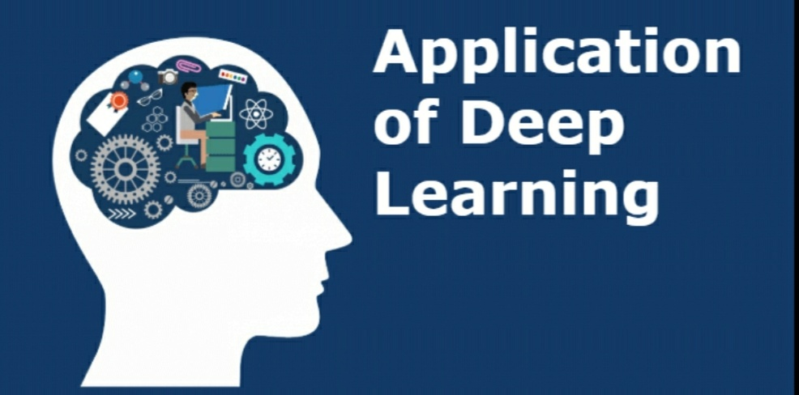
Deep Learning Applications
Deep Learning Applications
Natural language processing
Self-driving car
Pattern recognition
Natural language generation
Virtual assistant
Healthcare
Chatbot
Computer vision
10.Drug discovery
11. medical research
12.Face recognition
1
Sanjivani College of Engineering, Kopargaon.

Slide 17
Advantages of artificial intelligence
Reduction in Human Error
Takes risks instead of Humans
Available 24x7:
Helping in Repetitive Jobs
1
Sanjivani College of Engineering, Kopargaon.

Slide 18
Disadvantages Of artificial intelligence
High Costs of Creation
Making Humans Lazy
Unemployment
No Emotions
Lacking Out of Box Thinking
Digital Assistance
Faster Decisions
Daily Applications
New Inventions
1
Sanjivani College of Engineering, Kopargaon.

Slide 19
References:-
https://youtu.be/iyb38dzetRk
https://en.m.wikipedia.org/wiki/Artificial_intelligence
https://towardsdatascience.com/advantages-and-disadvantages-of-artificial-intelligence-182a5ef6588c
1
Sanjivani College of Engineering, Kopargaon.

Slide 20
THANK YOU
1
Sanjivani College of Engineering, Kopargaon.

